Slide 1
Going Data-driven: Software Quality Metrics Explained
Damian A. Tamburri, Ph.D.

Slide 2
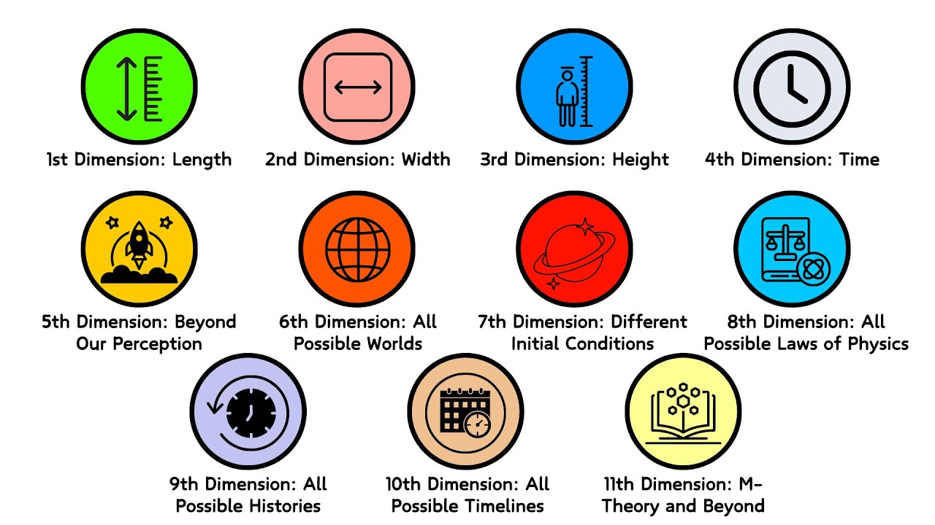

Slide 3
If you can’t measure it, you can’t manage it
Tom De Marco, 1982

Slide 4


Slide 5
It is wrong to suppose that if you can’t measure it, you can’t manage it – a costly myth.”
W. Edwards Demings, 2018

Slide 6
Measurement, Measures, Metrics
Measurement
  is the act of obtaining a measure
Measure
  provides a quantitative indication of the size of some product or process attribute, E.g., Number of errors
Metric
  is a quantitative measure of the degree to which a system, component, or process possesses a given attribute (IEEE Software Engineering Standards 1993) : Software Quality - E.g., Number of errors found per person hours expended

Slide 7
What to measure
Process
Measure the efficacy of processes. What works, what doesn't.
Project
Assess the status of projects. Track risk. Identify problem areas. Adjust workflow.
Product
Measure predefined product attributes

Slide 8
What to measure
Process
Measure the efficacy of processes. What works, what doesn't.
Code quality
Programmer productivity
Software engineer productivity
  Requirements,
  design,
  testing
  and all other tasks done by software engineers
Software
  Maintainability
  Usability
  And all other quality factors
Management
  Cost estimation
  Schedule estimation, Duration, time
  Staffing

Slide 9
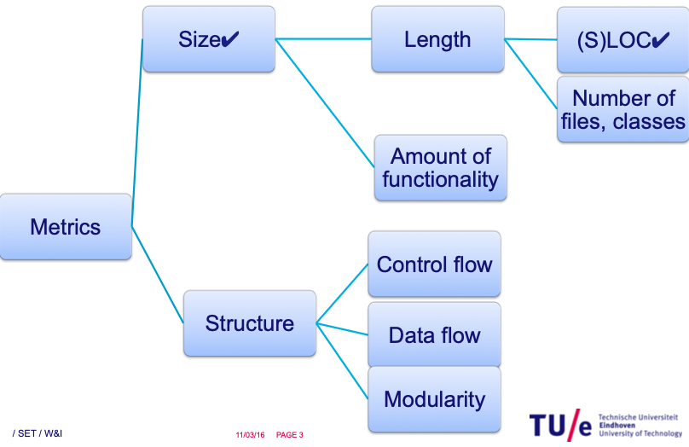

Slide 10
Motivation for Metrics
Estimate the cost & schedule of future projects
Evaluate the productivity impacts of new tools and techniques
Establish productivity trends over time
Improve software quality
Forecast future staffing needs
Anticipate and reduce future maintenance needs

Slide 11
Process Metrics
Process metrics are measures of the software development process, such as
  Overall development time
  Type of methodology used
Process metrics are collected across all projects and over long periods of time.
Their intent is to provide indicators that lead to long-term software process improvement.

Slide 12
Project Metrics
Project Metrics are the measures of Software Project and are used to monitor and control the project. Project metrics usually show how project manager is able to estimate schedule and cost
They enable a software project manager to:
  Minimize the development time by making the adjustments necessary to avoid delays and potential problems and risks.
  Assess product cost on an ongoing basis & modify the technical approach to improve cost estimation.

Slide 13
Product metrics
Product metrics are measures of the software product at any stage of its development, from requirements to installed system. Product metrics may measure:
  How easy is the software to use
  How easy is the user to maintain
  The quality of software documentation
  And more ..

Slide 14

Why do we measure?
Determine quality of piece of software or documentation
Determine the quality work of people such software engineers, programmers, database admin, and most importantly MANAGERS
Improve quality of a product/project/ process

Slide 15

Why Do We Measure?
To assess the benefits derived from new software engineering methods and tools
To close the gap of any problems (E.g training)
To help justify requests for new tools or additional training

Slide 16


Slide 17
Types of Measures
Direct Measures (internal attributes)
  Cost ($$), effort (in man/days), LOC (lines of code), response speed, memory footprint
  white box viewpoint
Indirect Measures (external attributes)
  Functionality, complexity, efficiency, reliability, maintainability (more on this later in the course)
  Black box viewpoint
Both pertain to quality?

Slide 18
Size-Oriented Metrics
Size of the software produced:
  LOC - Lines Of Code
  KLOC - 1000 Lines Of Code
  SLOC – Statement Lines of Code (ignore whitespace)
Popular because easy to compute
Typical Metrics:
  Errors/KLOC, Defects/KLOC, Cost/LOC, Documentation Pages/KLOC

Slide 19
Complexity Metrics
LOC - a ‘rough’ function of complexity
Halstead’s Software Science
  (entropy measures, i.e., measures towards (quality?) equilibrium…)
  n₁ - number of distinct operators
  n₂ - number of distinct operands
  N₁ - total number of operators
  N₂ - total number of operands

Slide 20
Example
if (k < 2)
{
if (k > 3)
x = x*k;
}
Distinct operators: if ( ) { } > < = * ;
Distinct operands: k 2 3 x
n₁ = 10
n₂ = 4
N₁ = 13
N₂ = 7

Slide 21
Halstead’s Metrics
Program length: N = N₁ + N₂
Program vocabulary: n = n₁ + n₂
Volume V = N * log₂ n
Difficulty D = (n1/2) + (N2/n2)
Effort E = D x V
Time to program T = (E / 18) seconds
Number of delivered bugs B = V / 3000
Halsted
  (entropy measures, i.e., measures towards (quality?) equilibrium…)
  n₁ - number of distinct operators
  n₂ - number of distinct operands
  N₁ - total number of operators
  N₂ - total number of operands

Slide 22
McCabe’s Complexity Measures
McCabe’s metrics are based on a control flow representation of the program.
A control flow graph is used to depict control flow.
Nodes represent processing tasks (one or more code statements)
Edges represent control flow between nodes

Slide 23
Flow Graph Notation
While
Sequence
If-then-else
Until

Slide 24
Cyclomatic Complexity
Defined as the set of independent paths through the control flow graph
V(G) = E – N + 2
  E is the number of flow graph edges
  N is the number of nodes
V(G) = P + 1
  P is the number of predicate nodes

Slide 25
Example
i = 0;
while (i<n-1) do
j = i + 1;
while (j<n) do
if A[i]<A[j]
then
swap(A[i], A[j]);
end do;
i=i+1;
end do;

Slide 26
Flow Graph
1
2
3
7
4
5
6

Slide 27
Computing V(G)
V(G) = 9 – 7 + 2 = 4
V(G) = 3 + 1 = 4
Basic paths are:
  1, 7
  1, 2, 6, 1, 7
  1, 2, 3, 4, 5, 2, 6, 1, 7
  1, 2, 3, 5, 2, 6, 1, 7

Slide 28
Meaning of V(G)
Complexity increases with the number of decision paths and loops
V(G) is a quantitative measure of the testing difficulty and, ultimately, an indication of reliability
Experimental data shows value of V(G) should be no more then 10: testing is very difficult above this value

Slide 29
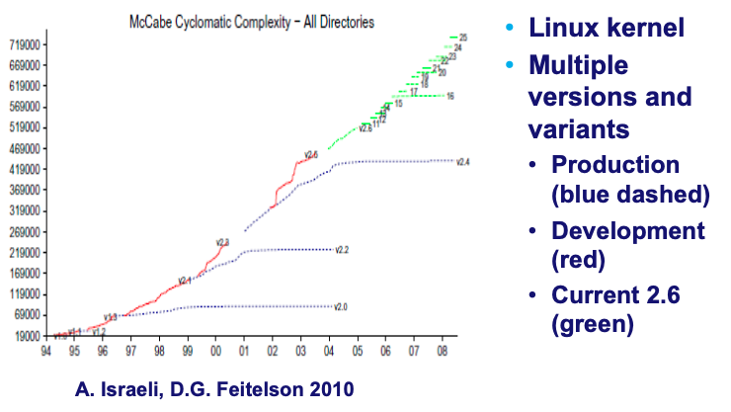
McCabe’s complexity in Linux kernel

Slide 30
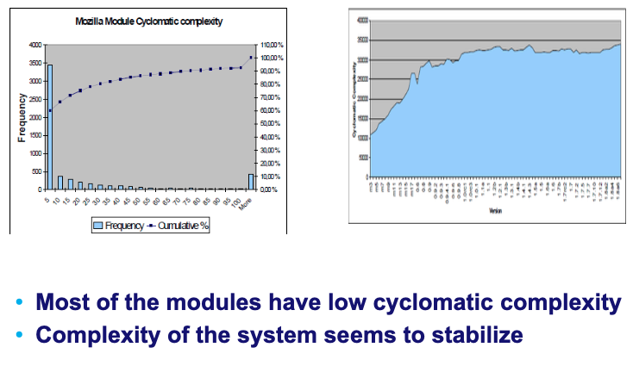
McCabe’s complexity in Mozilla [Røsdal 2005]

Slide 31
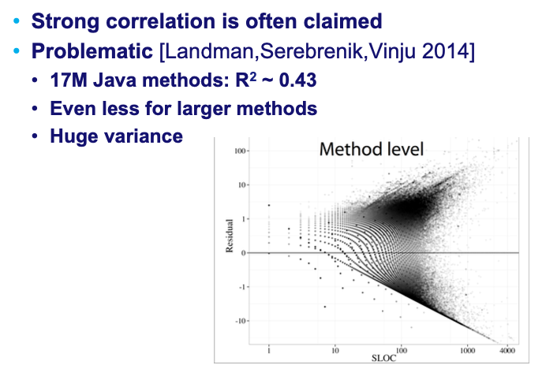
CC vs SLOC

Slide 32
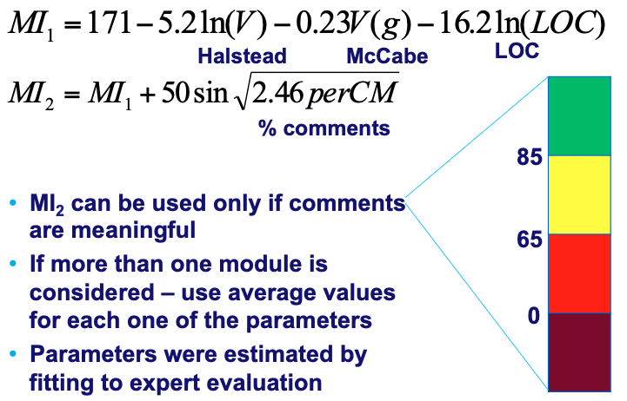
Summarizing: Maintainability index (MI)
[Oman & Coleman, 1994]

Slide 33
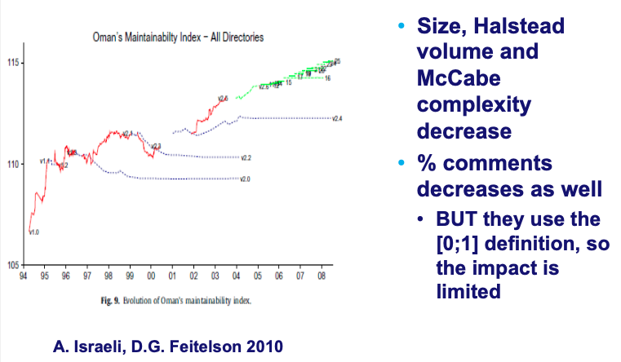
Evolution of the maintainability index in Linux

Slide 34
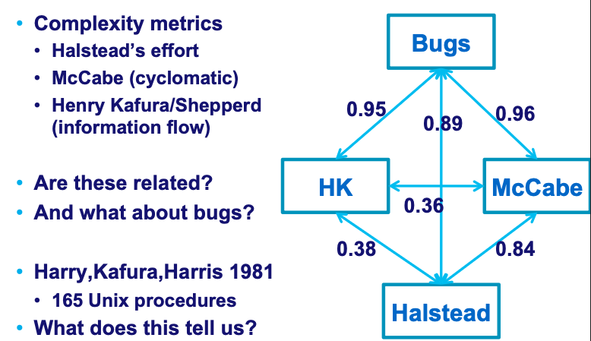
Overall SOTA synthesis

Slide 35
McClure’s Complexity Metric
Complexity = C + V
  C is the number of comparisons in a module
  V is the number of control variables referenced in the module (from ifs and loops)
  Targets decisional complexity
    Somewhat pertains to path sensitization
Similar to McCabe’s but with regard to control variables.
  Can this be correlated to software quality?
Notes:
And there is McCall’s Triangle of Quality…

Slide 36
Quality Model
(is ISO 9126 relevant to this?)
product
operation
revision
transition
reliability
efficiency
usability
maintainability
testability
portability
reusability
Metrics

Slide 37
High Level Design Metrics
Structural Complexity
Data Complexity
System Complexity
Structural Complexity S(i) of a module i.
  S(i) = f_{out}²(i)
  Fan out is the number of modules immediately subordinate (directly invoked).

Slide 38
Design Metrics
Data Complexity D(i)
  D(i) = v(i)/[f_{out}(i)+1]
  v(i) is the number of inputs and outputs passed to and from i
System Complexity C(i)
  C(i) = S(i) + D(i)
  As each C(i) increases the overall complexity of the architecture increases

Slide 39
System Complexity Metric
Another metric:
  length(i) * [f_{in}(i) + f_{out}(i)]²
  Length is (total?) LOC
  Fan in is the number of modules that invoke i
The real question: what are ‘good’ numbers for each of these metrics?

Slide 40
Coupling for a module
Data and control flow: (a key distinction)
  d_{i} input data parameters
  c_{i} input control parameters
  d_{o} output data parameters
  c_{o} output control parameters
Global
  g_{d} global variables for data
  g_{c} global variables for control
Environmental
  w fan in
  r fan out

Slide 41
Metrics for Coupling
M_{c} = k/m, k=1
  m = d_{i} + ac_{i} + d_{o} + bc_{o} + g_{d} + cg_{c} + w + r
  Key point: a, b, c, k can be adjusted based on actual data… but how is this done?
    This computation can be so subjective that most will rely on simpler (if not simplistic) metrics…

Slide 42
Component Level Metrics
Cohesion (internal interaction) – pertains to data members
Coupling (external interaction) - a function of input and output parameters, global variables, and modules called
Complexity of program flow - hundreds have been proposed (e.g., cyclomatic complexity)
Cohesion – difficult to measure
  Bieman ’94, TSE 20(8)

Slide 43
Using Metrics
The Process
  Select appropriate (??) metrics for problem
  Use metrics on problem
  Assess and generate feedback
Steps:
  Formulation
  Collection
  Analysis
  Interpretation
  Feedback

Slide 44

Metrics for Software Quality
D. A. Tamburri

Slide 45
Metrics for the Object Oriented
Chidamber & Kemerer ’94 TSE 20(6)
Metrics specifically designed to address object-oriented software
Class-oriented metrics:
  No need for procedure level metrics
  Cluster level metrics is simply too complex
  Simple direct measures

Slide 46
Chidamber and Kemerer Metrics
Weighted methods per class (MWC)
Depth of inheritance tree (DIT)
Number of children (NOC)
Coupling between object classes (CBO)
Response for class (RFC)
Lack of cohesion metric (LCOM)

Slide 47
Weighted methods per class (WMC)
c_{i} is the complexity of each method M_{i} of the class
  Often, only public methods are considered
Complexity may be the McCabe complexity of the method
Smaller values are better
Perhaps the average complexity per method is a better metric

Slide 48
Weighted Methods per Class
Viewpoints from Chidamber and Kemerer:
-The number of methods and complexity of methods is an indicator of how much time and effort is required to develop and maintain the object
-The larger the number of methods in an object, the greater the potential impact on the children
-Objects with large number of methods are likely to be more application specific, limiting possible reuse

Slide 49
Depth of inheritance tree (DIT)
For the system under examination, consider the hierarchy of classes
DIT is the length of the maximum path from the node to the root of the tree
Relates to the scope of the properties
  How many ancestor classes can potentially affect a class
Smaller values are better

Slide 50
Number of children (NOC)
For any class in the inheritance tree, NOC is the number of immediate children of the class
  The number of direct subclasses
How would you interpret this number?
A moderate (??) value indicates scope for reuse and high values may indicate an inappropriate abstraction in the design

Slide 51
Number of Children
Viewpoints:
As NOC grows, reuse increases - but the abstraction may be diluted
Depth is generally better than breadth in class hierarchy, since it promotes reuse of methods through inheritance
  Really?? Open-closed principle? Does this not contradict heuristic for DIT?
Classes higher up in the hierarchy should have more sub-classes then those lower down
NOC gives an idea of the potential influence a class has on the design: classes with large number of children may require more testing

Slide 52
Coupling between Classes
CBO is the number of collaborations between two classes (fan-out of a class C)
  the number of other classes that are referenced in the class C (where a reference to another class, A, is a reference to a method or a data member of class A)
Viewpoints:
High fan-outs denote class coupling to other classes/objects and thus are undesirable. High fan-ins denote good designs and a high level of reuse
Not possible to maintain high fan-in and low fan outs across the entire system
Excessive coupling indicates weakness of class encapsulation and may inhibit reuse
High coupling also indicates that more faults may be introduced due to inter-class activities

Slide 53
Response for class (RFC)
Mc_{i:} # of methods called in response to a message that invokes method M_{i}
  Fully nested set of calls
Smaller numbers are better
  Larger numbers indicate increased complexity and debugging difficulties
If a large number of methods can be invoked in response to a message, the testing and debugging of the class becomes more complicated

Slide 54
Lack of cohesion metric (LCOM)
Number of methods in a class that reference a specific instance variable
A measure of the “tightness” of the code
If a method references many instance variables, then it is more complex and less cohesive
The larger the number of similar methods in a class the more cohesive the class is
“Cohesion of methods within a class is desirable, since it promotes encapsulation” (??)

Slide 55
Lack of Cohesion in Methods
LCOM – poorly described in Pressman
Class C_{k} with n methods M₁,…M_{n}
I_{j} is the set of instance variables used by M_{j}

Slide 56
LCOM
There are n such sets I₁ ,…, I_{n}
  P = {(I_{i}, I_{j}) | (I_{i} ∩ I_{j} ) = ∅} //no common inst. var.
  Q = {(I_{i}, I_{j}) | (I_{i} ∩ I_{j} ) ≠ ∅}
If all n sets I_{i} are ∅ then P = ∅
LCOM = |P| - |Q|, if |P| > |Q|
LCOM = 0 otherwise

Slide 57
Explanation
LCOM is the number of empty intersections minus the number of non-empty intersections
This is a notion of degree of similarity of methods
If two methods use common instance variables then they are (??) similar
LCOM of 0 is not maximally cohesive*
|P| = |Q| or |P| < |Q|
*A class in which each variable is used by each method is maximally cohesive.

Slide 58
Class Size
CS
  Total number of operations (inherited, private, public)
  Number of attributes (inherited, private, public)
May be an indication of too much responsibility for a class

Slide 59
Number of Operations Overridden
NOO
A large number for NOO indicates possible problems with the design
Poor abstraction in inheritance hierarchy

Slide 60
Number of Operations Added
NOA
The number of operations added by a subclass
As operations are added the subclass ‘moves away’ from the parent class
As depth increases NOA should decrease

Slide 61
Method Inheritance Factor
MIF = .
M_{i}(C_{i}) is the number of methods inherited and not overridden in C_{i}
M_{a}(C_{i}) is the number of methods that can be invoked with C_{i} (see next slide)
M_{d}(C_{i}) is the number of methods declared in C_{i} (see next slide)

Slide 62
MIF
M_{a}(C_{i}) = M_{d}(C_{i}) + M_{i}(C_{i})
Meaning: All that can be invoked = (new or overloaded) + things inherited
MIF is [0,1]
MIF near 1 means little specialization
MIF near 0 means large change

Slide 63
Coupling Factor
CF= .
is_client(x,y) = 1 iff a relationship exists between the client class and the server class. 0 otherwise
(TC²-TC) is the total number of relationships possible (where TC is the # of classes)
  Entails relationships are not bidirectional
  Formula calculates xproduct - diagonal
CF is [0,1] with 1 meaning high coupling

Slide 64
Polymorphism Factor
PF = .
M_{n}() is the number of new methods
M_{o}() is the number of overriding methods
DC() is the number of descendent classes of a base class
The factor is computed as the number of methods that redefine inherited methods, divided by the maximum number of possible distinct polymorphic situations (!!): ie assume all new methods are polymorphic!!

Slide 65
Operations Oriented Metrics (i.e., DevOps)
Average operation size (LOC, volume)
Number of messages sent by an operator
Operational complexity – (often cyclomatic compl.)
Average number of parameters/operation
  The larger the number the more complex the collaboration

Slide 66
Measuring Encapsulation?
Lack of cohesion indicates potential lack of encapsulation
Consider % of public and protected
  What would this indicate??
Public access to data members
  What would this indicate??

Slide 67
Inheritance?
Number of root classes
Fan in – multiple inheritance
NOC, DIT, etc.

Slide 68
Software Volume
KLOC — classic metric that measures the size of software by thousands of code lines.
Number of function points (NFP) — a measure of the development resources (human resources) required to develop a program, based on the functionality specified for the software system.

Slide 69
Is KLOC enough ?
What about number of errors (error density)?
What about types of errors (error severity) ?
A mixture of KLOC, density, and severity is an ideal quality metric to programmers quality of work and performance

Slide 70
Process metrics categories
Software process quality metrics, e.g.:
  Error density metrics
  Error severity metrics
Software process timetable metrics;
Software process error removal effectiveness metrics;
Software process productivity metrics;

Slide 71
Error density metrics
Code | Name | Calculation formula
CED | Code Error Density | NCE CED = ----------- KLOC
DED | Development Error Density | NDE DED = ----------- KLOC
WCED | Weighted Code Error Density | WCE WCDE = --------- KLOC
WDED | Weighted Development Error Density | WDE WDED = --------- KLOC
WCEF | Weighted Code Errors per Function Point | WCE WCEF = ---------- NFP
WDEF | Weighted Development Errors per Function Point | WDE WDEF = ---------- NFP
NCE = The number of code errors detected by code inspections and testing.
NDE = total number of development (design and code) errors) detected in the development process.
WCE = weighted total code errors detected by code inspections and testing.
WDE = total weighted development (design and code) errors detected in development process.

Slide 72
Error severity metrics
Code | Name | Calculation formula
ASCE | Average Severity of Code Errors | WCE ASCE = ----------- NCE
ASDE | Average Severity of Development Errors | WDE ASDE = ----------- NDE
NCE = The number of code errors detected by code inspections and testing.
NDE = total number of development (design and code) errors detected in the
development process.
WCE = weighted total code errors detected by code inspections and testing.
WDE = total weighted development (design and code) errors detected in
development process.

Slide 73
Software process
timetable metrics
Code | Name | Calculation formula
TTO | Time Table Observance | MSOT TTO = ----------- MS
ADMC | Average Delay of Milestone Completion | TCDAM ADMC = ----------- MS
MSOT = Milestones completed on time.
MS = Total number of milestones.
TCDAM = Total Completion Delays (days, weeks, etc.) for all milestones.

Slide 74
Error removal
effectiveness metrics
Code | Name | Calculation formula
DERE | Development Errors Removal Effectiveness | NDE DERE = ---------------- NDE + NYF
DWERE | Development Weighted Errors Removal Effectiveness | WDE DWERE = ------------------ WDE+WYF
NDE = total number of development (design and code) errors) detected in the
development process.
WCE = weighted total code errors detected by code inspections and testing.
WDE = total weighted development (design and code) errors detected in
development process.
NYF = number software failures detected during a year of maintenance service.
WYF = weighted number of software failures detected during a year of maintenance
service.

Slide 75
Process productivity
metrics
Code | Name | Calculation formula
DevP | Development Productivity | DevH DevP = ---------- KLOC
FDevP | Function point Development Productivity | DevH FDevP = ---------- NFP
CRe | Code Reuse | ReKLOC Cre = -------------- KLOC
DocRe | Documentation Reuse | ReDoc DocRe = ----------- NDoc
DevH = Total working hours invested in the development of the software system.
ReKLOC = Number of thousands of reused lines of code.
ReDoc = Number of reused pages of documentation.
NDoc = Number of pages of documentation.

Slide 76
Product metrics
categories
* Help Desk (HD) quality metrics:
* HD calls density metrics - measured by the number of calls.
* HD calls severity metrics - the severity of the HD issues raised.
* HD success metrics – the level of success in responding to HD calls.
* HD productivity metrics.
* HD effectiveness metrics.
* Corrective maintenance quality metrics.
* Software system failures density metrics
* Software system failures severity metrics
* Failures of maintenance services metrics
* Software system availability metrics
* Corrective maintenance productivity and effectiveness metrics.

Slide 77
HD calls density metrics
Code | Name | Calculation Formula
HDD | HD calls density | NHYC HDD = -------------- KLMC
WHDD | Weighted HD calls density | WHYC WHYC = ------------ KLMC
WHDF | Weighted HD calls per function point | WHYC WHDF = ------------ NMFP
NHYC = the number of HD calls during a year of service.
KLMC = Thousands of lines of maintained software code.
WHYC = weighted HD calls received during one year of service.
NMFP = number of function points to be maintained.

Slide 78
Severity of HD calls metrics
Code | Name | Calculation Formula
ASHC | Average severity of HD calls | WHYC ASHC = -------------- NHYC
NHYC = the number of HD calls during a year of service.
WHYC = weighted HD calls received during one year of service.

Slide 79
HD success metrics
Code | Name | Calculation Formula
HDS | HD service success | NHYOT HDS = -------------- NHYC
NHYNOT = Number of yearly HD calls completed on time during one year of service.
NHYC = the number of HD calls during a year of service.

Slide 80
HD productivity and
effectiveness metrics
Code | Name | Calculation Formula
HDP | HD Productivity | HDYH HDP= -------------- KLNC
FHDP | Function Point HD Productivity | HDYH FHDP = ---------- NMFP
HDE | HD effectiveness | HDYH HDE = -------------- NHYC
HDYH = Total yearly working hours invested in HD servicing of the software system.
KLMC = Thousands of lines of maintained software code.
NMFP = number of function points to be maintained.
NHYC = the number of HD calls during a year of service.

Slide 81
Software system
failures density metrics
Code | Name | Calculation Formula
SSFD | Software System Failure Density | NYF SSFD = -------------- KLMC
WSSFD | Weighted Software System Failure Density | WYF WFFFD = --------- KLMC
WSSFF | Weighted Software System Failures per Function point | WYF WSSFF = ---------- NMFP
NYF = number of software failures detected during a year of maintenance service.
WYF = weighted number of yearly software failures detected during one year of
maintenance service.
NMFP = number of function points designated for the maintained software.
KLMC = Thousands of lines of maintained software code.

Slide 82
Failures of maintenance
services metrics
Code | Name | Calculation Formula
MRepF | Maintenance Repeated repair Failure metric - | RepYF MRepF = -------------- NYF
NYF = number of software failures detected during a year of maintenance
service.
RepYF = Number of repeated software failure calls (service failures).

Slide 83
Software system
availability metrics
Code | Name | Calculation Formula
FA | Full Availability | NYSerH - NYFH FA = ----------------------- NYSerH
VitA | Vital Availability | NYSerH - NYVitFH VitA = ----------------------------- NYSerH
TUA | Total Unavailability | NYTFH TUA = ------------ NYSerH
NYSerH = Number of hours software system is in service during one year.
NYFH = Number of hours where at least one function is unavailable (failed) during one year,
including total failure of the software system.
NYVitFH = Number of hours when at least one vital function is unavailable (failed) during
one year, including total failure of the software system.
NYTFH = Number of hours of total failure (all system functions failed) during one year.
NYFH ≥ NYVitFH ≥ NYTFH.
1 – TUA ≥ VitA ≥FA

Slide 84
User-based Metrics
Understanding
  Learning time: Time for new user to gain basic understanding of features of the software
Ease of learning
  Learning time: Time for new user to learn how to perform basic functions of the software
Operability
  Operation time: Time required for a user to perform operation(s) of the software
Usability
  Human factors: Number of negative comments from new users regarding ergonomics, human factors, etc.

Slide 85
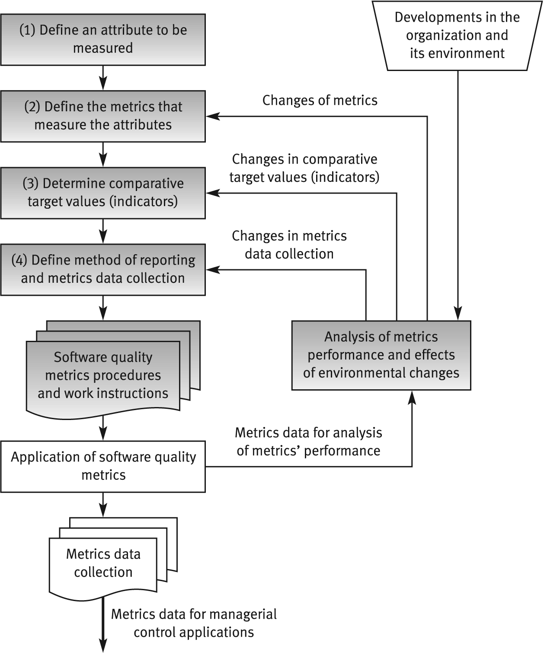
How do I define my own?*
* Basili et al.
Notes:
https://www.cs.umd.edu/users/mvz/handouts/gqm.pdf

Slide 86
General limitations of
quality metrics
* Budget constraints in allocating the necessary resources.
* Human factors, especially opposition of employees to evaluation of their activities.
* Validity Uncertainty regarding the data's, partial and biased reporting.

Slide 87
Summary
Many metrics exist, uses range, automations are available!
Costs are different than 0, shall be considered in maintenance plan;
Automated fixes are preferrable!
New metrics can be incepted for innovative systems;

Slide 88
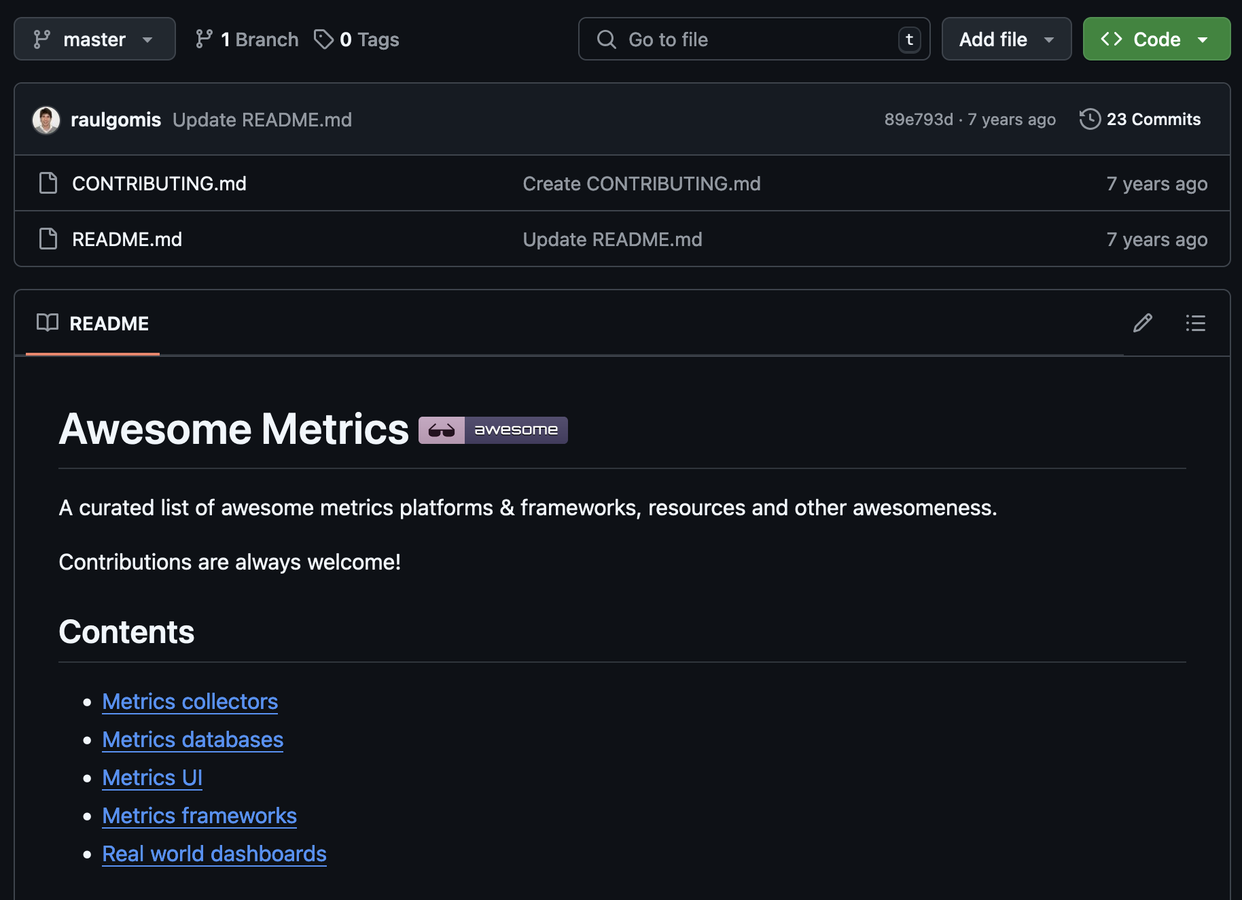

Slide 89

Questions?

